Slide 1

Car Buying Strategies
(Updated June 2025)
Disclaimer: The information presented in this lesson does not constitute legal, tax, investment, financial, or other advice. This lesson is intended as an informational resource to assist you in identifying or exploring resources and options for managing your personal financial situation.

Slide 2
Agenda
Essential steps before you buy
Determine affordability
New, pre-owned or lease
Negotiation tips
Financing options
Insurance considerations
Car Buying Strategies

Slide 3
Activity: Car Feature Preference
Rate each characteristic below as either a high priority or low priority when purchasing a car.
1. Fuel efficiency
2. Price
3. Safety
4. Brand
5. Size
6. Features
7. Comfort
8. Quality
High Priority
Low Priority
Car Buying Strategies

Slide 4
Essential Steps Before You Buy
Research vehicles that meet your needs and preferences
Check your credit
Get preapproved
Check your spending plan
Assess your trade-in
Shop for your vehicle
Car Buying Strategies

Slide 5

Determine Affordability
Evaluate your financial situation
Review your monthly income after taxes
List your monthly expenses
    Housing costs, utilities, groceries, etc.
Determine how much is left after the essential expenses
Set a baseline
Avoid overextending your spending plan
Car Buying Strategies

Slide 6




Activity: Car Payment Calculation Challenge
Use the Car Loan Calculator to determine the monthly loan payment or purchase price plus the total interest paid on the scenarios below.
New Truck: $48,000 at 9% interest rate for six years
Pre-owned sedan: Monthly loan payment of $800 at 7.8% for four years
New electric vehicle: $39,000 at 6.5% for five years
Pre-owned sports car: Monthly loan payment of $650 at 7% for five years
Car Buying Strategies

Slide 7
Determine a Reasonable Car Payment
Keep your total car expenses within 15%-20% of your pretax income.
Use the FINRED Car Loan Calculator to estimate monthly loan payments.
Ensure your payment allows you to contribute to your other financial goals.
Consider potential changes to your cash flow.
Balance affordability with minimizing interest costs.
Car Buying Strategies

Slide 8


Understand the Risk of Negative Equity
Factors of negative equity
Depreciation
Low down payment
Long loan terms
  High interest rates
  Paying more than market value
Steps to avoid negative equity
Make a larger down payment
Chose a shorter loan term
Consider depreciation rates
Avoid overpaying
Be cautious with extras
Additional payments
Car Buying Strategies

Slide 9
Considerations for Buying New
Pros
Cons
Latest technology
Manufacturer warranty coverage
Low maintenance
Financing incentives
Higher resale value
Higher purchase price, taxes, and registration fees
Rapid depreciation
More expensive insurance
Car Buying Strategies

Slide 10
Pros and Cons of Pre-Owned
Pros
Cons
Less expensive
Less depreciation
Lower insurance premiums
Certified Pre-owned Options (CPO) are available
Wide variety of vehicle options
More frequent maintenance
Limited or no warranties
Vehicle history may not be fully transparent
Lack of latest technology
Potential unfavorable finance terms
Car Buying Strategies

Slide 11
Leasing Considerations
Pros
Cons
Lower monthly payments
Lower upfront costs
Ability to drive newer models
Under warranty
No need to sell or trade in
No concern for future market value
Potential early termination protection under SCRA
You do not own the vehicle
Upfront costs apply
Early termination charges
Limited miles you can drive
Charged for wear to the vehicle
Payment to re-lease or purchase
Tax implications
Car Buying Strategies

Slide 12
Negotiation Tips
Do your homework
Secure pre-approval for financing
Set a limit and stick to it
Be willing to walk away
Negotiate each part separately
Focus on total price, not the monthly payment
Be patient
Use silence to your advantage
Request a detailed breakdown
Get everything in writing
Timing matters
Car Buying Strategies

Slide 13
Financing Options
Dealership financing
Online lenders
Financing directly through dealership
Review terms for interest rates
Negotiate and compare the terms
Convenience and competitive rates
Fast preapproval
Research first for reputable lenders
Bank or credit union loans
Manufacturer financing
Competitive interest rates
Gives a clear idea of spending plan
Credit union members may receive lower rates and better terms
Financing through the manufacturer
Can include special incentives, such as cash-back offers, low interest rates, or extended warranty plans
Car Buying Strategies

Slide 14



Finance Charges
Add-on interest
Interest is calculated for the length of the loan then added to the principal.
More expensive due to paying the same interest amount for each payment.
Simple interest
Interest is calculated on the outstanding principal balance of the loan.
Each payment reduces the principal, and interest is recalculated on the lower principal.
Most common type of auto loan
State usury laws
Laws limit the amount of interest that can be charged on a loan.
Truth in Lending Act requires annual percentage rate disclosure in financing documents.
Car Buying Strategies

Slide 15
Reviewing the Contract
Description
Condition
Purchase price and fees
Trade-in information
Financing terms
Manufacturer's warranty
Insurance coverage
Right to cancel
Additional clauses
Car Buying Strategies

Slide 16
Types of Insurance Coverage
Liability Insurance
Collision Insurance
Comprehensive Insurance
Personal Injury Protection/Medical Payments Coverage
Uninsured/Underinsured Motorist Coverage
Gap Insurance
Car Buying Strategies

Slide 17
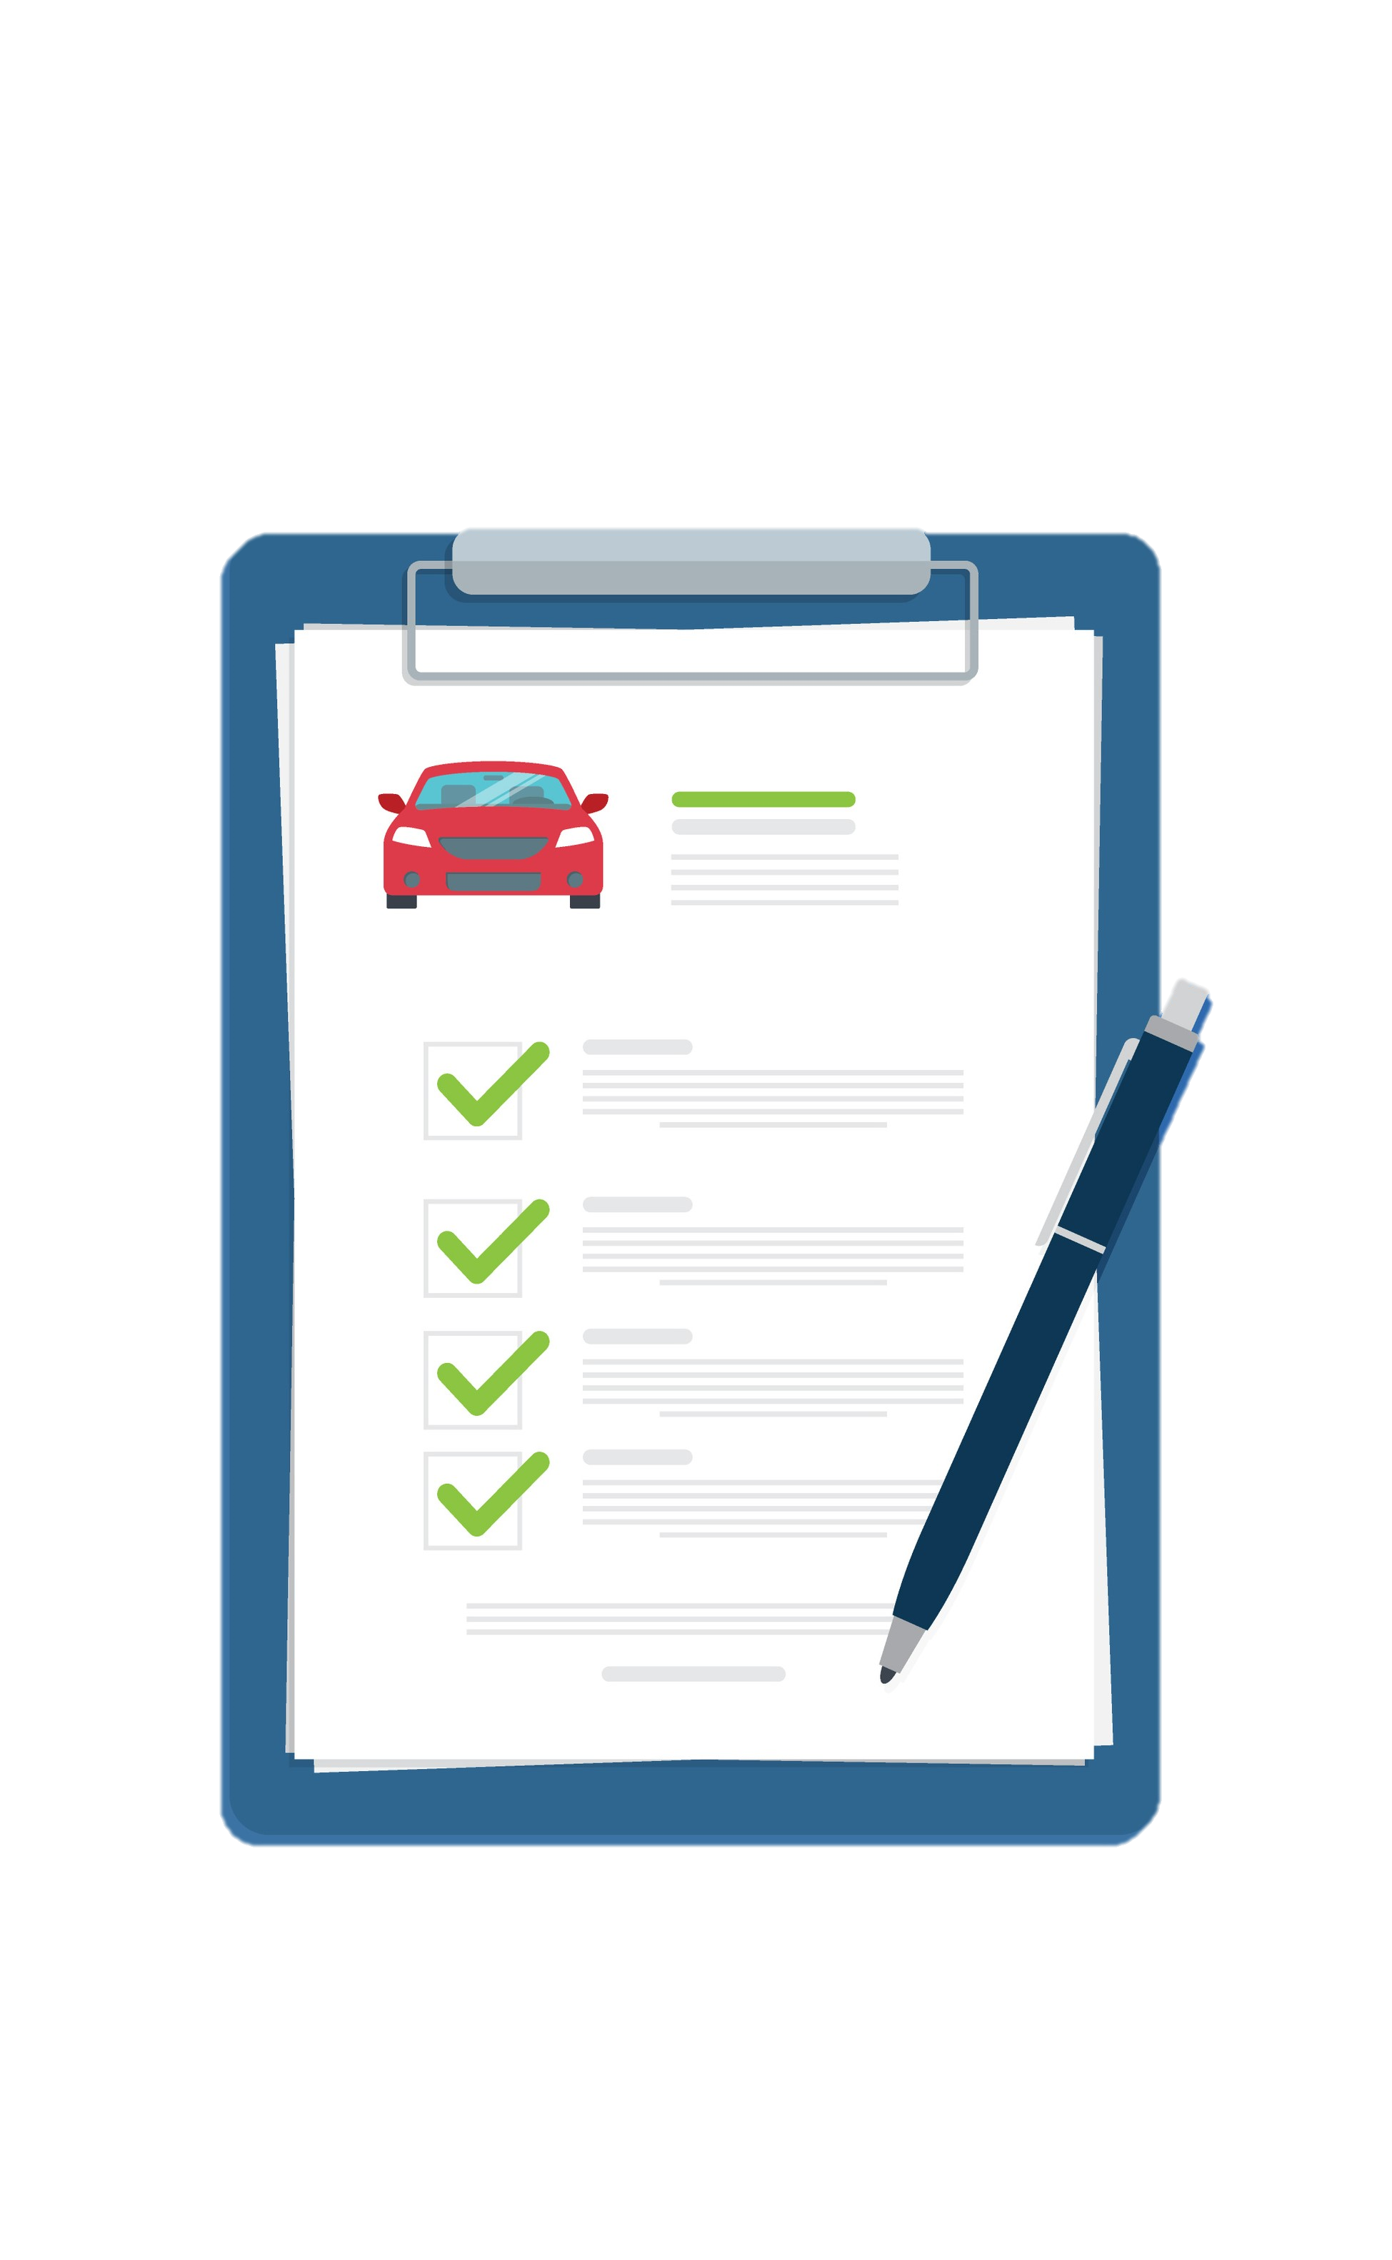
Minimizing Insurance Costs
Compare quotes
Safety feature discounts
Chose a higher deductible
Check your credit report
Discount eligibility
Avoid coverage lapses
Drive safely
Consider need for gap insurance
Car Buying Strategies

Slide 18

Sources of Help
Personal Financial Managers, Personal Financial Counselors, or Financial Readiness Program Specialists at your local military and family support center
  Military relief organization
  Command/Unit Financial Specialist (USN, USMC, USCG)
Car Buying Strategies

Slide 19

Resources
Available Resources
  The DoD Office of Financial Readiness (FINRED) Car Buying Basics — https://finred.usalearning.gov/Money/CarBuyingBasics
  FINRED – Major Purchases — https://finred.usalearning.gov/Money#Major-Purchases
  FINRED – Auto Calculators — https://finred.usalearning.gov/ToolsAndAddRes/Calculators/Auto
  Sen$e app — https://finred.usalearning.gov/ToolsAndAddRes/Sen$e#gsc.tab=0
  Federal Trade Commission — https://consumer.ftc.gov/articles/buying-used-car-dealer
  Credit reports — https://www.annualcreditreport.com/index.action
Car Buying Strategies

Slide 20
Conclusion
Essential steps before you buy
Determine affordability
New, pre-owned or lease
Negotiation tips
Financing options
Insurance considerations
Car Buying Strategies

